Slide 1
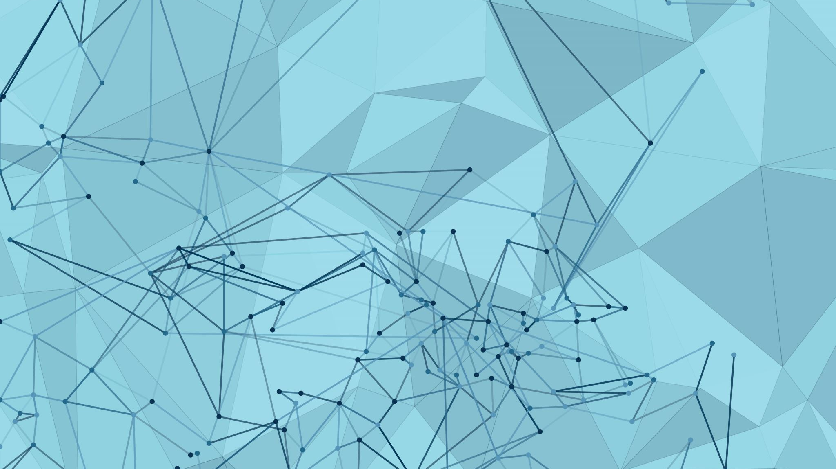
Sudoku Solver
Presented by the Sudoku Solvers: Michael Lieu and Will Schreiner

Slide 2
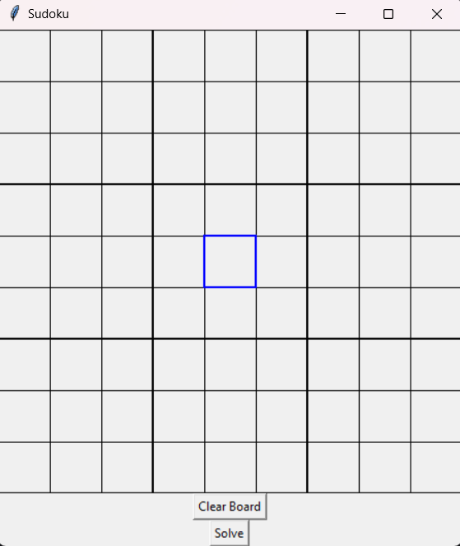
Purpose and Goals
Purpose: Provide a program for solving Sudoku problems of varying difficulty without relying on computer-solvable algorithms such as backtracking
Goals:
Design and develop a Graphic User Interface for a Sudoku Board that allows the user to traverse the board, input values, and display solved board
Design and develop a backend for the Sudoku Board that takes inputs from the GUI, implements human-solvable algorithms to solve the board, and passes solved values to the GUI
Integrate the GUI and backend implementations into a cohesive and fully synthesized product

Slide 3
The Sudoku Solvers
Michael Lieu
Computer Science ’24
Favorite Programming Language: Python
Co-Op(s): Resurgent Capital Services
Co-Op Role: Software Developer Intern
Project Role: Frontend Developer
Email: lieumh@mail.uc.edu
Project Advisor: Fred Annexstein
Will Schreiner
Computer Science ’24
Favorite Programming Language: Python
Co-Op(s): Knauf
Co-Op Role: Software Developer Intern
Project Role: Backend Developer
Email: schreiwa@mail.uc.edu
Project Advisor: Fred Annexstein

Slide 4
Abstract
This project is centered around the design and development of a Sudoku Solver programmed entirely in Python. This involves the implementation of a user-friendly GUI using TkInter tools that will allow the user to interact with the board and the implementation of functions containing algorithms that will take inputs from the GUI, solve the board based on those inputs, and pass them to the GUI. The main distinction of this project is the utilization of human-solvable algorithms as opposed to computer solvable algorithms, the latter of which rely on brute force tactics while the human-solvable algorithms are more intuitive in nature.

Slide 5
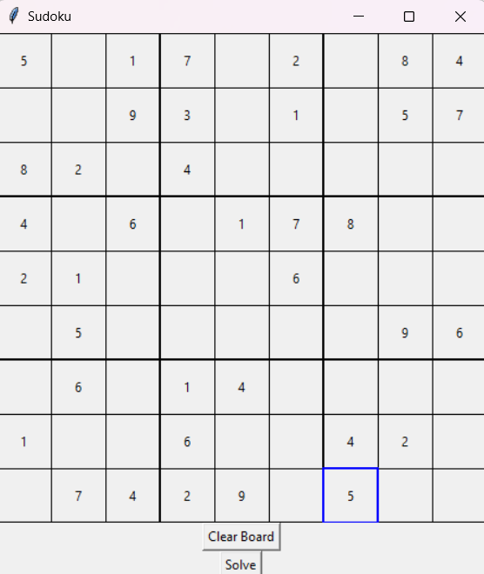
User Stories
As a Player, I want the square I have selected to be highlighted, so that I can read the board easier
As a Player, I want to be able to traverse the board using mouse clicks and arrow keys, so that I can access cells according to my preference
As a Player, I want to be able to replace a square’s value without having to manually delete the square’s current value, to make interactivity with the board more fluid.
As a Player, I want to be able to solve Sudoku puzzles of varying difficulty, so that I can solve any board.

Slide 6
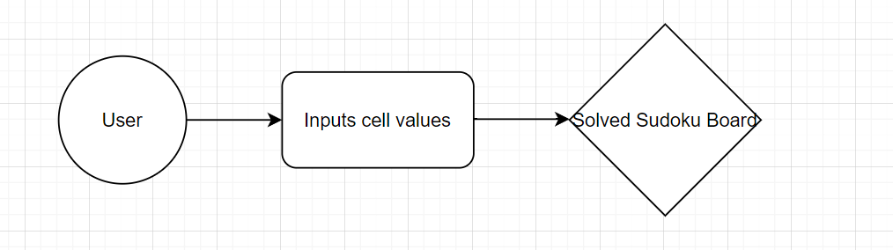
Design Diagrams: D0

Slide 7
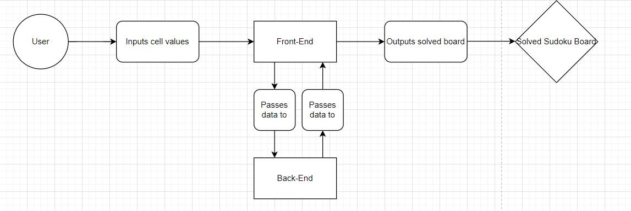
Design Diagrams: D1

Slide 8
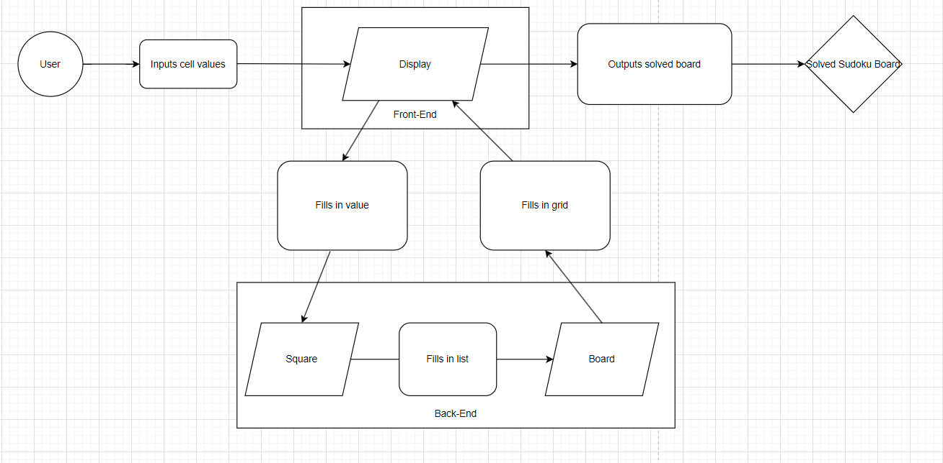
Design Diagrams: D2

Slide 9




Major Project Constraints
Economic
Python
Visual Studio Code
GitHub
TkInter
Economic and intellectual freedom
Professional
Professional technologies such as Python, Visual Studio Code, and GitHub
Practices such as frontend development, backend development, project management, system change management

Slide 10
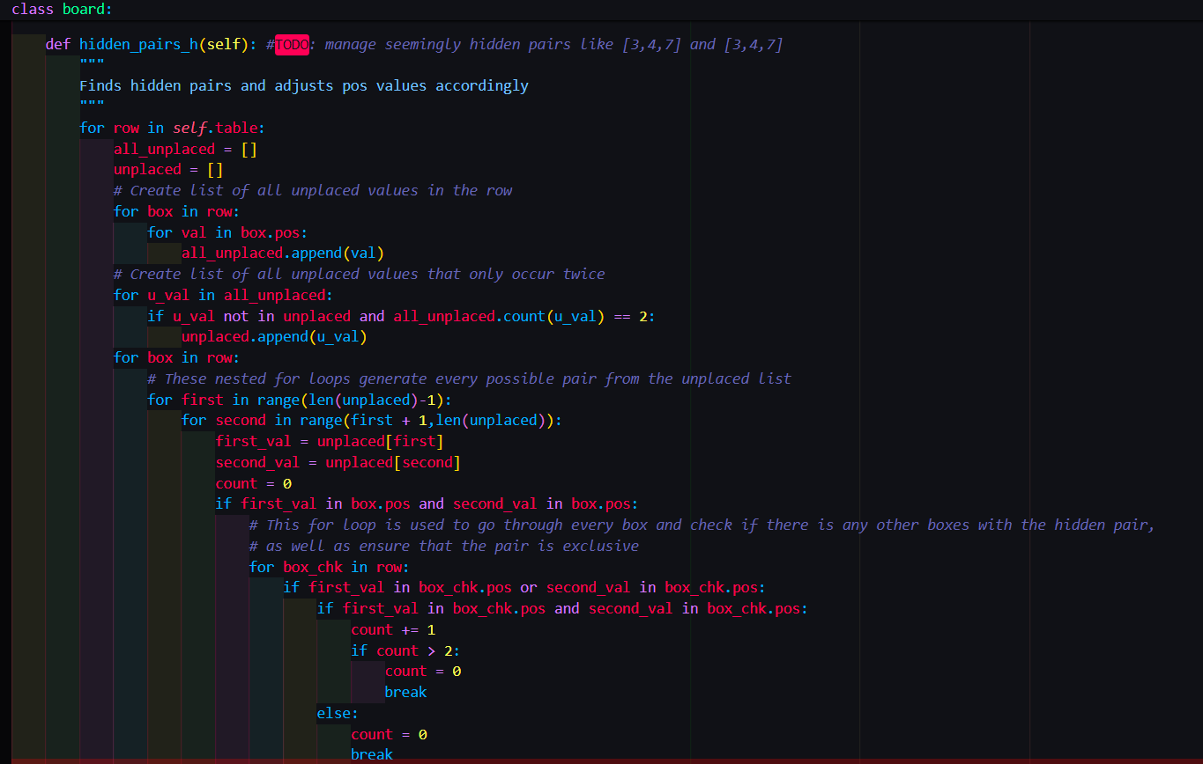
Review of Project Progress
Sudoku GUI implementation developed
Traversal, interactivity, and accessibility features implemented
Sudoku GUI integrated with solving backend of program
Sudoku Square and Board classes developed
Human-solvable algorithms implemented
Test cases developed and tested for boards of varying difficulty

Slide 11
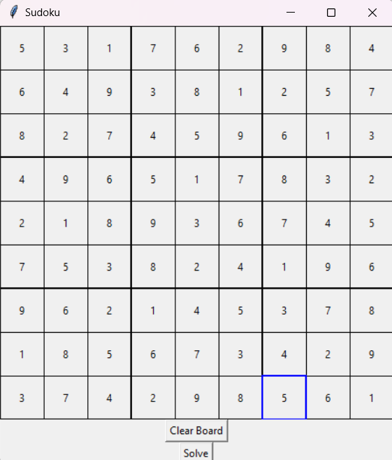
Expected Accomplishments
Refine human-solvable algorithms
Implement backtracking algorithm for comparison with human-solvable algorithms and complete solving functionality
More accessibility options for GUI

Slide 12
Division of Work
Task | Member Responsible
Research TkInter and GUI design implementations of Sudoku boards (Michael Lieu) | Michael Lieu
Design and develop the implementation of the visual Sudoku GUI’s board (Michael Lieu) | Michael Lieu
Design and develop the implementation of traversing across the visual Sudoku GUI and quality of life features (Michael Lieu) | Michael Lieu
Design and develop the implementation of inputting, deleting, and replacing values for the Sudoku GUI (Michael Lieu) | Michael Lieu
Integrate the back-end implementation with the front-end implementation of the program (Michael Lieu) | Michael Lieu
Design data structure for sudoku board | Will Schreiner
Design and develop the Square class | Will Schreiner
Design and develop Board class structure; basic data functions, and board maintenance functions | Will Schreiner
Design basic solve functions and unit tests | Will Schreiner
Design advanced solve functions and unit tests (hidden + naked pairs) and unit tests | Will Schreiner
Design backtracking solve functions and unit tests for non-human solvable fallback | Will Schreiner

Slide 13
Demo

Slide 14
References/Links for Images
https://en.m.wikipedia.org/wiki/File:Visual_Studio_Code_1.35_icon.svg
https://en.wikipedia.org/wiki/GitHub
https://en.wikipedia.org/wiki/Python_%28programming_language%29
https://stackoverflow.com/tags/tkinter/info

